Slide 1
Arizona State retirement system
NEPC 2018 SAAP Review
April 30, 2018
Allan Martin, Partner
Chris Levell, Partner
Don Stracke, CFA, CAIA
Mike Malchenko, Sr. Analyst

Slide 2
ASRS process
NEPC updates 5-7 and 30 year asset class forecasts annually
Every 3 years, NEPC evaluates the ASRS long-term Strategic Asset Allocation Policy (SAAP) and works with staff as well as independently to identify changes to SAAP targets to improve the probability of producing high expected returns at a comparable level of risk
Multiple tools are used to assess the potential advantages and challenges of proposing a new SAAP or retaining the current SAAP
One methodology employed involves projected mean/variance analysis (Modern Portfolio Theory) to project likely outcomes from alternative asset mixes. Page 21 contains a summary and recommendation for new SAAP Targets
Once the Investment Committee selects a target mix, NEPC will work with staff to develop ranges and benchmarks for each asset class for final approval by the Board

Slide 3
Current asset allocation and ranges
Assets | Current Allocation | SAAP | Policy Range | Within Range | Benchmark
Total Domestic and International Equity | 51.2% | 50%
Domestic Equity | 27.0% | 26% | 16% - 36% | Yes
U.S. Large Cap | 19.5% | 20% |  |  | S&P 500 Index
U.S. Mid Cap | 3.3% | 3% |  |  | S&P 400 Index
U.S. Small Cap | 3.3% | 3% |  |  | S&P 600 Index
Public Opportunistic Equity |  |  |  |  | Investment Specific
International Equity | 24.2% | 24% | 14% - 34% | Yes
Developed Large Cap | 17.6% | 17% |  |  | MSCI EAFE Index
Developed Small Cap | 1.5% | 2% |  |  | MSCI EAFE Small Cap Index
Emerging Markets | 4.4% | 5% |  |  | MSCI Emerging Markets Index
Private Equity | 8.1% | 8% | 6% - 10% | Yes | Russell 2000 Index
Private Opportunistic Equity | 0.7% | 0% |  |  | Investment Specific
Total Equity | 60.0% | 58% | 48% - 65% | Yes
Public Markets Fixed Income | 11.4% | 13%
Treasuries Long Duration | 0.0% | 0% | 0% - 10% | Yes | Bbg Barclays Long-Term Treasuries Index
Interest Rate Sensitive | 10.6% | 11% |  |  | Bbg Barclays US Aggregate Bond Index
High Yield | 0.8% | 2% |  |  | Bbg Barclays US High Yield Index
Private Debt² | 10.9% | 12% | 8% - 12% | Yes | S&P/ LSTA Leveraged Loan Index + 2.5%
Opportunistic Debt | 3.9% | 0%
Total Fixed Income | 26.2% | 25% | 18% - 35% | Yes
Commodities | 0.6% | 2% | 0% - 4% | Yes | Bloomberg Commodities Index
Real Estate | 8.9% | 10% | 8% - 12% | Yes | NCREIF ODCE Index
Infrastructure | 0.9% | 0% | 0% - 3% | Yes | Investment Specific
Farmland and Timber | 0.5% | 0% | 0% - 3% | Yes | Investment Specific
Opportunistic Inflation-Linked | 0.0% | 0% |  |  | Investment Specific
Total Inflation-Linked | 10.9% | 12% | 10% - 16% | Yes
Multi-Asset Class Strategies | 3.0% | 5% | 0% - 12% | Yes | 91 Day T-Bill
Operating Cash (Non Assetized) | 0.0% |  |  |  | 91 Day T-Bill
Note: As of 12/31/2017

Slide 4
Asset Allocation Defined
The process of allocating assets across a spectrum of investments to achieve an expected return at an expected level of risk
“Expected” is a statistics term, which is different from the common use of the word.
Expected return is the weighted average of all possible returns, where the weights are the probabilities that each return will occur.
Asset allocation decisions include, but are not limited to:
Equity/Fixed Income/Cash/Real Estate/Private Equity/Private Debt etc.
Domestic/International/Global
Liquid vs. illiquid
Structure: refers to implementation decision
Core vs. Value/Growth
All Cap vs. Large/Medium/Small Cap
Active vs. Passive
Global vs. US/Foreign

Slide 5
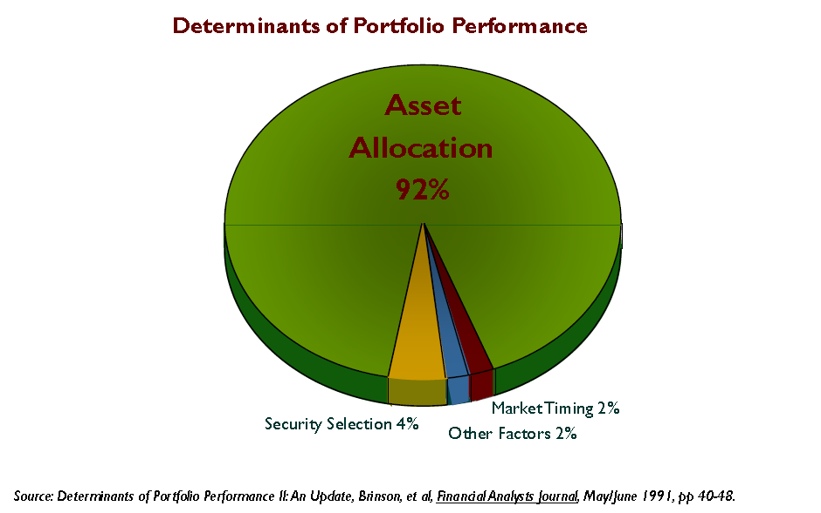
Asset Allocation: The Key Investment Decision

Slide 6


Asset Allocation – A Progressive Approach
Build a Mosaic
No single asset allocation approach or model has all the answers
Minimize exposure to the shortcomings of any individual approach by using multiple perspectives and approaches
All analytical tools have the potential to provide useful insights but also including shortcomings
Be Dynamic
Build a long-term strategic allocation that can meet long-term objectives
Look for medium-term “opportunistic ideas” to tilt away from the strategic allocation to add value, AND

Slide 7
Analytical Modeling Capabilities – Proprietary Tools
NEPC uses a variety of proprietary tools developed internally to better assess strategic asset allocation changes and the impact of tactical adjustments
Final Result = Revised Asset Class Targets, Ranges, Benchmarks
Remainder of this Document Focuses on Determining Asset Class Targets
Approach | Advantages | Shortcomings
Mean-Variance | Calculates most efficient portfolio for given volatility Produces range of portfolios | Relies on static assumptions and assumes normal distribution Chosen constraints can drive results Limits risk definition to volatility
Risk Budgeting | Provides risk allocations Recognizes that less efficient portfolios may have better risk balance | Relies on Mean-Variance optimization assumptions Defines risk as standard deviation Ignores tail risks
Scenario Analysis | Focuses on low-probability, high magnitude economic environments (tail risks) Recognizes environmental biases of each asset class | Offers opportunity to test risk tolerance to various outcomes but should not be used to construct best portfolio for each environment
Liquidity Analysis | Recognizes a “risk” not captured in traditional tools: illiquidity Highlights impact of changing cash flows (both investment-driven and exogenous) | Requires portfolio specific cash flow and partnership details Long-term planning tool – cannot easily adjust portfolio or compare different portfolios
Please note that all investments carry some level of risk. No investment strategy or risk management technique can guarantee returns or eliminate risk in any market environment.

Slide 8
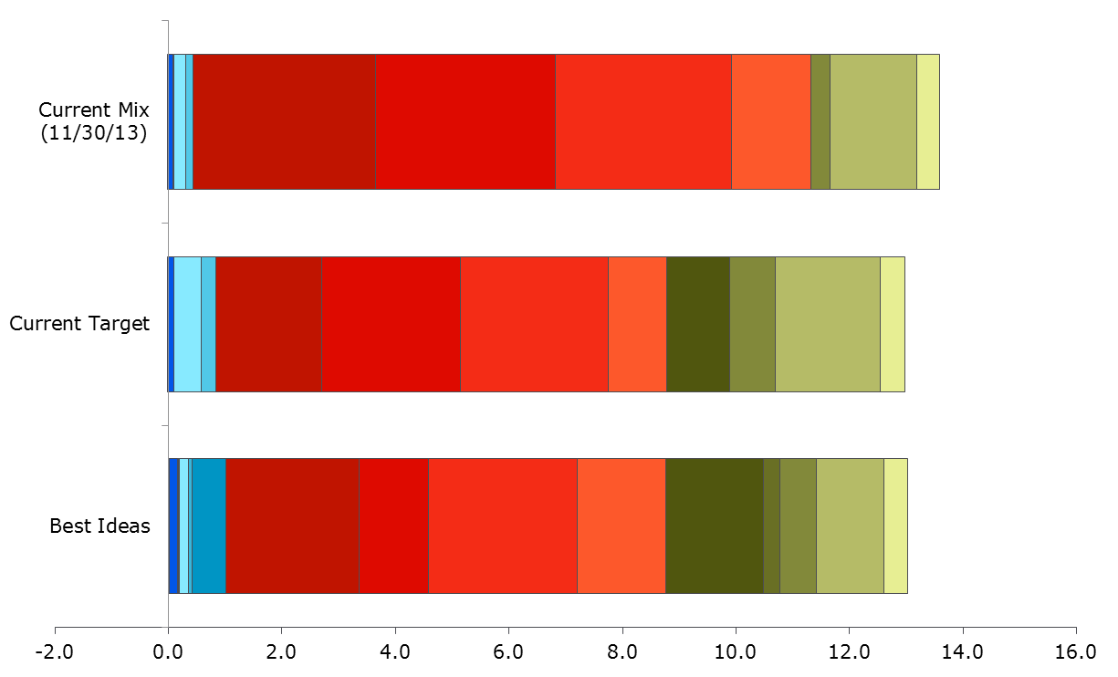
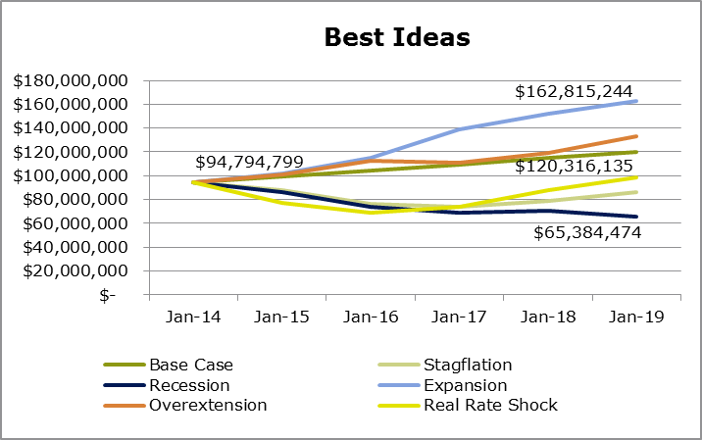
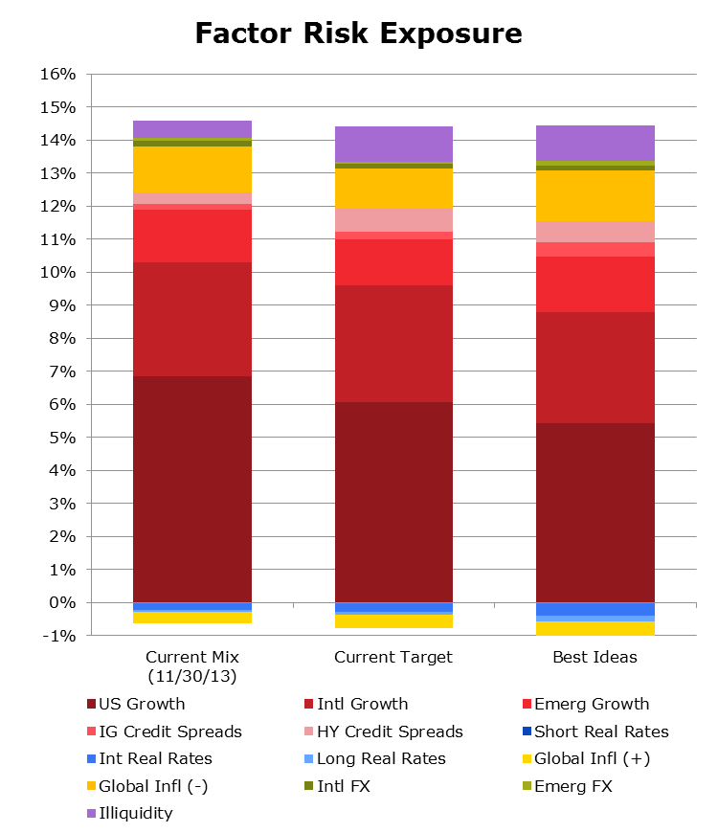
Asset Allocation
Risk Budgeting
Use forward-looking, fundamental based assumptions for all forecasting
Outlook for intermediate and long-term
Identify opportunities for enhancing portfolio structure shorter-term
Apply multiple models to build robust, objective driven asset allocation solutions
Multiple perspectives on the portfolio provide a more comprehensive understanding of portfolio expectations and behavior in various environments
Mean-variance optimization
Risk budgeting
Liquidity analysis
Scenario analysis
Factor analysis
Peer Group Analysis
We embrace innovation in asset allocation
Continuously work to develop new models to analyze and stress test current and potential allocations
Equity Risk
Asset Growth
Notes:
Give years of how these unfolded and how it helped clients.

Slide 9
Asset Allocation Process
Capital markets assumptions
Expected Return
Expected Risk (Volatility, Standard Deviation)
Expected Correlation
A portfolio is comprised of a set of asset classes, each of which has a return distribution, which can be summarized by return and variance
The expected return of the total fund is simply a weighted average of the expected returns of its component asset classes
The standard deviation of the total fund is more complex

Slide 10
Asset Allocation Model: Mean-Variance Optimization
Mean-Variance Optimization: Asset allocation model based on Nobel-Prize winning theory
Mathematical solution to determine the “best” mix of assets that will create an efficient frontier
Highest return for expected risk (volatility), or
Lowest expected risk (volatility) for expected return
Stated another way, it builds portfolios with the highest expected risk-adjusted returns – Efficient Frontier:
Efficient Frontier Portfolios
Return
Inefficient Portfolios
Standard Deviation ( )
σ

Slide 11
Model Inputs
Permissible Asset Classes and Weighting Constraints
Constraints may reflect legal restrictions, liquidity, time horizon and marginal benefit analyses
Example: RE constrained to 20% to reflect liquidity concerns
Not all asset classes may be permissible by some plans
(e.g. Hedge Funds, Emerging Market Debt)
Return and Risk Assumptions
Based on historic data, academic theory, and NEPC’s assessment of current and future market conditions
Uncertainty Risk measured by Standard Deviation (volatility)
Correlation Assumptions
Measure of similarity/dissimilarity between asset class returns
Based on historic data, adjusted for current market conditions

Slide 12
Input 1: Returns
Arithmetic – simple average of annual returns
Example
Year 1: 10%
Year 2: -4%
Year 3: 15%
Average (arithmetic) return is 7% (21% cumulative divided by 3 years)
Geometric – Our reports reflect compounding of annual returns
Example
Year 1: 10%
Year 2: -4%
Year 3: 15%
Compounded annualized (geometric) return is 6.69%
Geometric returns are always less than arithmetic returns
Reflects the fact that a given loss (say 10%) is worse than it’s equivalent gain
For example, you start with $100 and lose 50%. You now have $50. To get back to $100, you will need to earn 100%
Highlights the need to consider variance as a key element – Two portfolios with the same average return will exhibit significantly different compound returns
Portfolio 1 Annual Returns (%): 8, 8, 8, 8, 8
Portfolio 2 Annual Returns (%): 10, -5, 15, 12, 8
Portfolios 1 and 2 exhibit the same average arithmetic return (8%), however Portfolio 2 has a lower geometric return (7.77%) caused by additional volatility

Slide 13
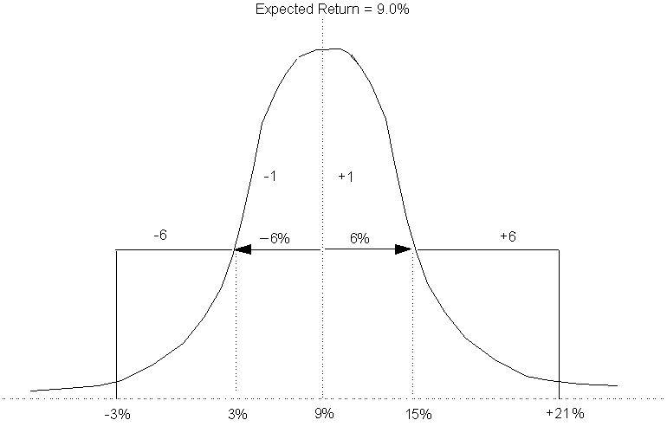
Input 2: Volatility (Risk)
The Bell Curve - One Standard Deviation
66.6% of all observations lie within one standard deviation of the mean
σ
σ
Standard Deviation (Risk, Volatility)
13

Slide 14
Input 2: Standard Deviation Notes
Standard Deviation is not risk, but it helps understand an element of risk
Most asset class returns approximate a Bell Curve (normal distribution)
But not a perfect fit.
So, take Standard Deviation with a grain of salt

Slide 15
Input 3: Correlation
Measures how two things vary relative to each other
Scale is from –1.0 to 1.0
+1.0 is perfect correlation
The two things behave exactly alike
0.0 indicates no correlation
–1.0 is perfect negative correlation
The two things behave exactly opposite of each other
One goes up while the other goes down
Partial Correlation is common
Correlations between assets are very important in the asset allocation process
Combining unlike assets lessens portfolio volatility
Year 1
Year 2
Year 3
A
20%
-5%
0%
B
-10%
15%
10%
Portfolio
10%
10%
10%

Slide 16
Input 3: Correlation Illustrations
Expected Return
Expected Return
8.0
Asset B
8.1
7.8
Asset B
7.7
7.6
7.5
Mix
7.4
Mix
7.3
7.2
7.1
Asset A
7.0
Asset A
6.9
0.0
1.0
2.0
3.0
4.0
5.0
6.0
7.0
8.0
9.0
10.0
11.0
12.0
6.8
Standard Deviation (Risk)
0.0
1.0
2.0
3.0
4.0
5.0
6.0
7.0
8.0
9.0
10.0
11.0
12.0
Perfect Positive Correlation: +1.0
Standard Deviation (Risk)
Positive Correlation: +0.5
Expected Return
Expected Return
8.1
8.1
7.8
Asset B
Asset B
7.6
7.8
7.4
Mix
7.6
7.2
7.4
Mix
7.0
7.2
6.8
Asset A
7.0
Asset A
0.0
1.0
2.0
3.0
4.0
5.0
6.0
7.0
8.0
9.0
10.0
11.0
12.0
6.8
Standard Deviation (Risk)
0.0
1.0
2.0
3.0
4.0
5.0
6.0
7.0
8.0
9.0
10.0
11.0
12.0
Zero Correlation: 0.0
Standard Deviation (Risk)
Negative Correlation: -0.5
Expected Return
8.0
Asset B
7.7
The lower the correlation, the greater the risk reduction
7.5
Mix
7.3
7.1
Asset A
6.9
0.0
1.0
2.0
3.0
4.0
5.0
6.0
7.0
8.0
9.0
10.0
11.0
12.0
Standard Deviation (Risk)
Perfect Negative Correlation: -1.0

Slide 17
Input 3: Correlation Notes
Correlations are normally fairly stable
Market crisis: Correlations = 1.0
Diversification fails when you need it most
So, take correlation with a grain of salt

Slide 18
2018 Asset Class Assumptions
NEPC asset class assumptions offer both an intermediate (5-7 years) and long term (30 years) forecast horizon
November 30th market data is used for inputs to the asset class models
The 5-7 year return expectations for US credit and equity asset classes are broadly lower due to continued increases in valuation levels
Credit-based asset class expectations have declined considerably from prior year, with credit spreads moving below long-term medians across most sectors
The outlook for non-US equities remains attractive over 5-7 years supported by improvement in corporate earnings and economic growth
We anticipate US inflation will gradually move higher and average 2.5%
We continue to refine and enhance our process where appropriate
The asset class assumption for Real Estate reflects specific structure of ASRS program
We have developed forecasted returns for global factor portfolios

Slide 19
Assumption Development
Capital market assumptions are published for over 40 asset classes
Assumptions include 5-7 year and 30 year return forecasts, average annual volatility expectations, and correlations
The 5-7 year forecast is designed to capture the return outlook for the current investment cycle
30 year return assumptions reflect a long-term outlook and are informed by the historical relationships among asset classes
Assumptions are published annually on December 15th and use market data as of November 30th
Assumptions are developed by the Asset Allocation Committee and approved by the Partners Research Committee (PRC)
Return assumptions are developed with proprietary valuation models and rely on a core building block methodology
Asset Allocation Committee
September | Asset Allocation Committee Assumptions Kickoff Finalize List of New Asset Class Assumptions
October | Review Draft of Asset Class Return Assumptions Discuss Outlook with NEPC Research Beta Groups
November | Finalize Volatility and Correlation Assumptions Final Update of Asset Class Models (As of 11/30)
December | Review Model Output and Create Return Assumptions Present Draft to the PRC Publish Assumptions on December 15th

Slide 20
ASRS Portfolio

Slide 21
ASRS Portfolio – 2018 Assumptions
 | Current Target | ASRS/NEPC Recommendation | Alternate Mix | Current Allocation
Public Equity | 50.00% | 40.00% | 41.7% | 51.10%
Private Equity | 8.00% | 10.00% | 10.0% | 8.80%
Total Equity | 58.00% | 50.00% | 51.7% | 59.90%
Interest Rate Sensitive Bonds | 11.00% | 10.00% | 18.3% | 10.60%
Credit | 14.00% | 20.00% | 10.0% | 15.60%
Private Real Assets - Infrastructure/Land | 0.00% | 0.00% |  | 1.40%
Commodities | 2.00% | 0.00% |  | 0.60%
Real Estate | 10.00% | 20.00% | 20.0% | 8.90%
Total Multi Asset | 5.00% | 0.00% |  | 3.00%
Expected Return 5-7 yrs | 6.9% | 7.3% | 7.1% | 7.0%
Expected Return 30 yrs | 8.1% | 8.6% | 8.4% | 8.3%
Standard Dev | 12.0% | 10.9% | 10.9% | 12.2%
Sharpe Ratio (5-7 years) | 0.41 | 0.49 | 0.47 | 0.41
Sharpe Ratio (30 years) | 0.45 | 0.54 | 0.52 | 0.45
Probability of 1-Year Return Under 0% | 28.4% | 25.1% | 25.8% | 28.2%
Probability of 6-Year Return Under 0% | 8.1% | 5.0% | 5.6% | 7.9%
Probability of 6-Year Return Over 7.5% | 45.0% | 48.3% | 46.4% | 46.0%
Probability of 30-Year Return Over 7.5% | 61.4% | 70.6% | 67.1% | 63.3%
Note:
Real Estate assumption from RCLCo
Factor portfolio modeled using Momentum, Value, Size, Min Vol.
Includes accounting volatility in Private Equity and Private Debt
Securities lending modeled based on spread over US Leverage Cost

Slide 22
ASRS Portfolio – 2018 Assumptions
 | Current Target | ASRS/NEPC Recommendation | Alternative Mix | Current Allocation
Large Cap Equities | 20.0% | 12.1% | 14.2% | 15.2%
Large Cap Factors |  |  |  | 4.8%
Global Equity Factors |  | 10.0% | 6.7%
Small/Mid Cap Equities | 6.0% | 4.5% | 5.2% | 6.6%
Int'l Equities (Unhedged) | 19.0% | 8.5% | 9.9% | 18.6%
Int'l Sm Cap Equities (Unhedged) | 0.0% | 1.5% | 1.7% | 1.5%
Emerging Int'l Equities | 5.0% | 3.0% | 3.4% | 4.4%
Emerging Int'l Sm Cap Equities | 0.0% | 0.5% | 0.5% | 0.0%
Private Equity | 8.0% | 10.0% | 10.0% | 8.8%
Total Equity | 58.0% | 50.1% | 51.7% | 59.9%
Interest Rate Sensitive Bonds | 11.0% | 10.0% | 18.3% | 10.6%
High Yield Bonds | 2.0% | 0.0% |  | 0.8%
Credit | 12.0% | 20.0% | 10.0% | 14.8%
Total Fixed Income | 25.0% | 30.0% | 28.3% | 26.2%
Private Real Assets - Infrastructure/Land | 0.0% | 0.0% |  | 1.4%
Commodities | 2.0% | 0.0% |  | 0.6%
REITs | 0.0% | 0.0% |  | 0.0%
Real Estate | 10.0% | 20.0% | 20% | 8.9%
Total Real Assets | 12.0% | 20.0% | 20.0% | 10.9%
Global Asset Allocation | 5.0% | 0.0% |  | 3.0%
Total Multi Asset | 5.0% | 0.0% |  | 3.0%
Expected Return 5-7 yrs | 6.9% | 7.3% | 7.1% | 7.0%
Expected Return 30 yrs | 8.1% | 8.6% | 8.4% | 8.3%
Standard Dev | 12.0% | 10.9% | 10.9% | 12.2%
Sharpe Ratio (5-7 years) | 41.0% | 49.0% | 0.47 | 41.0%
Sharpe Ratio (30 years) | 45.0% | 54.0% | 0.52 | 45.0%
Probability of 1-Year Return Under 0% | 28.4% | 25.1% | 25.8% | 28.2%
Probability of 6-Year Return Under 0% | 8.1% | 5.0% | 5.6% | 7.9%
Probability of 6-Year Return Over 7.5% | 45.0% | 48.3% | 46.4% | 46.0%
Probability of 30-Year Return Over 7.5% | 61.4% | 70.6% | 67.1% | 63.3%
Note:
Real Estate assumption from RCLCo
Factor portfolio modeled using Momentum, Value, Size, Min Vol.
Includes accounting volatility in Private Equity and Private Debt
Securities lending modeled based on spread over US Leverage Cost

Slide 23
Mean-variance optimization
ASRS/NEPC Recommended
*
Constraints: - Private Equity + Private Debt + Real Estate <= 50%
- Public Equity constrained at market cap weights
- Global Factors max 25% of Global Equity
- Interest sensitive bonds constrained at >=5%

Slide 24
Risk budgeting
12.0%
Volatility (Std. Dev.)

Slide 25
Scenario Analysis
Current Allocation
ASRS/NEPC Recommendation
Current Target
In the Base Case scenario the ASRS/ NEPC Recommendation captures less upside potential as equity risk is reduced in favor of Credit and Real Assets
In the Recession scenario the ASRS/NEPC Recommendation captures less downside risk
Overall, the dispersion of outcomes in the ASRS/NEPC Recommendation is tighter; suggests greater efficiency

Slide 26
Liquidity analysis
The ASRS/NEPC Recommendation assumes more illiquidity risk; attempts to capture associated risk premium
Suggests sufficient liquidity in the plan exists to meet obligations
A more detailed liquidity analysis may be warranted in order to stress test liquidity constraints

Slide 27
KEY MARKET Themes

Slide 28
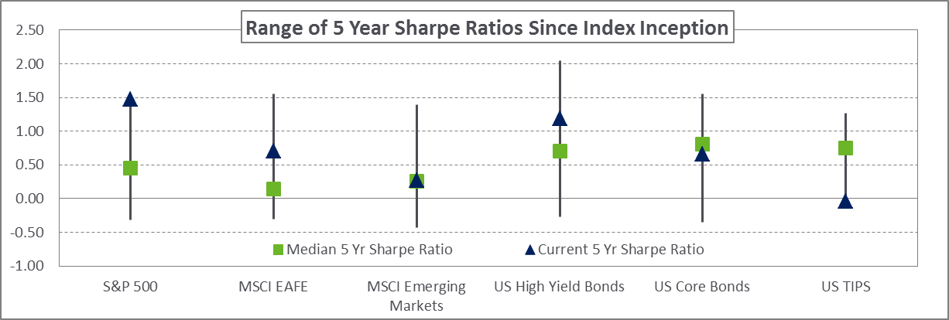
Themes - introdUction
The outlook for developed market equities outside the US has improved
Growth conditions across the globe are on the upswing supported by easy financial conditions and an improved corporate earnings outlook
We encourage reducing exposure to assets that have outperformed expectations over a prolonged period such as US stocks and high yield
Tilt exposure to assets underperforming expectations in recent years, particularly emerging market equities, developed market equities, and US TIPS
Market stability must not elicit complacency, we encourage investors to increase exposure to strategies that mitigate market drawdowns
Look to rebalance “safe haven” fixed income exposure back to strategic targets
Index Inception: S&P 500 - 1926, MSCI EAFE – 1970, MSCI EM – 1988, US High Yield – 1983, US Core Bonds – 1976, US TIPS – 1997
Source: Ibbotson-Morningstar, eVestment, Sharpe Ratio range spans 5th to 95th percentile

Slide 29
Key Market Themes
Extended US Economic Cycle
Synchronized Economic Resurgence
Federal Reserve Gradualism
China Transitions
Globalization Backlash

Slide 30
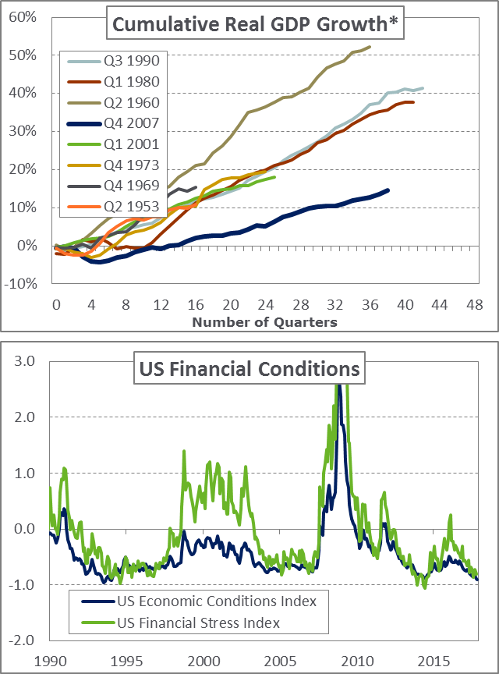
Key Market Themes
Extended US Economic Cycle
Economic cycles do not die of old age
The US economy is in an extended expansionary cycle despite being eight years removed from the last recession
Financial health of US consumers and ongoing recovery of the housing market continue to drive economic growth
A prolonged US economic expansion can support a continued rally for US equities despite elevated valuation levels
US financial conditions remain loose and support steady economic gains
Low inflation provides a foundation for positive economic conditions and reinforces the Fed’s gradual monetary policy approach
Moderating US dollar strength is another form of easy financial conditions, benefiting global trade flows and credit creation
Reversal in these easy conditions may be fueled by actions outside the US, such as a misstep by global central banks and/or increased volatility in the Chinese yuan
Tight
Loose
Source: (Top) Bloomberg,*Cumulative GDP growth from prior cycle peak
Source: (Bottom) Federal Reserve Bank of Chicago and Kansas City

Slide 31
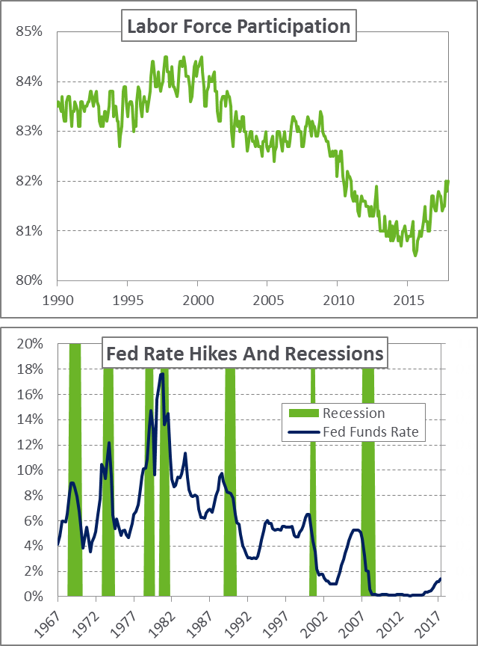
Key Market Themes
Extended US Economic Cycle
Excess capacity remains in the system and provides fuel for the expansion
Labor market gains have been robust but slack remains as many have not returned to the workforce
Muted wage gains and low inflation metrics are reflective of the excess capacity remaining in the US economy
Tax cuts and fiscal stimulus can potentially remove spare economic capacity and be a catalyst for an uptick in inflation measures
US recession concerns are muted
An acceleration in inflation leading to a tightening of financial conditions has historically been a catalyst to end economic expansions
However, improved US household balance sheets have room to expand and support further consumer spending gains
Improving global economic conditions reinforce an expansion of the US economy as global growth factors synchronize
Source: (Top) Federal Reserve Bank of St. Louis
Source: (Bottom) Federal Reserve, NEPC

Slide 32
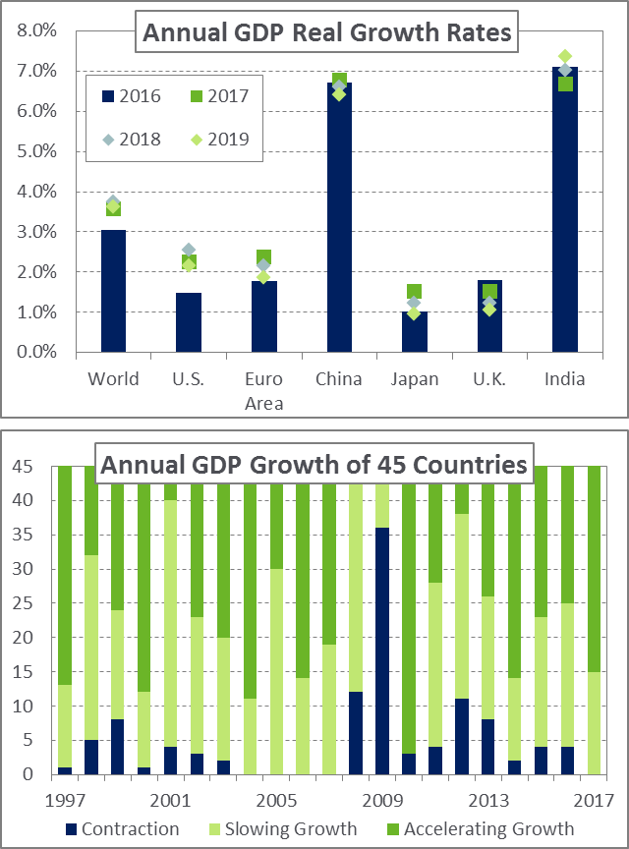
Key Market Themes
Synchronized Economic Resurgence
Global economic conditions are improving in a synchronized fashion
Coordinated global growth factors reinforce economic gains across the globe and are distinct from the extension of the US economic cycle
Non-US corporate revenues and equities are best positioned to benefit from a widespread boost in global economic conditions
Positive growth rates harmonized across the globe are relatively rare
Conditions are the result of Europe, Japan, and large parts of the emerging world transitioning out of economic malaise
Persistence of the theme over several years would provide a substantial benefit to equity markets globally – specifically in Europe and Japan
Historically, periods of synchronized growth have been derailed by higher inflation levels and central banks tightening policy
Source: (Top) OECD
Source: (Bottom) OECD

Slide 33
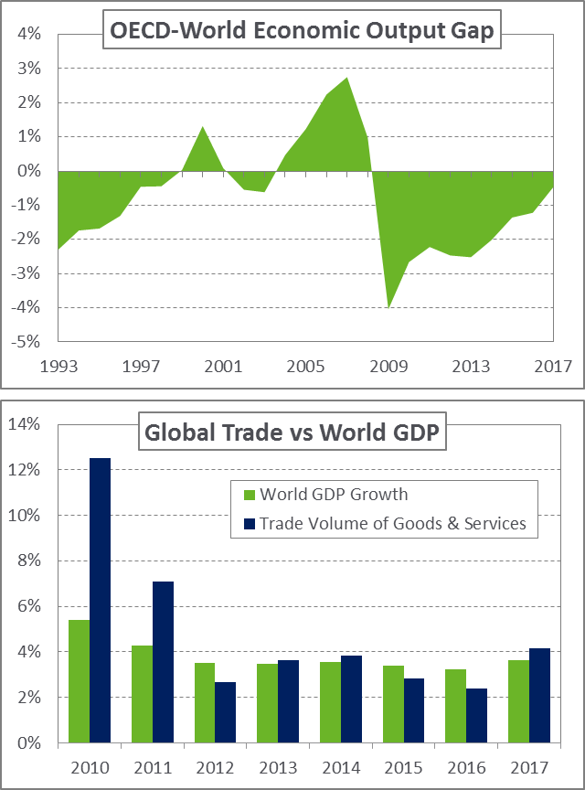
Key Market Themes
Synchronized Economic Resurgence
Erosion of excess economic capacity is a catalyst to boost economic gains
Despite recent labor market improvements, potential for labor reform in Europe and improved workforce participation in Japan offer multi-year benefits to economic growth
Material decline in emerging market inflation provides a cushion for real interest rates to fall and fuel an expansion of economic activity
Economic resurgence is delicate and can be disrupted by lingering global risk factors
US dollar strength, dislocation in China’s credit expansion, and restrictive US trade policy pose the greatest threats
The foundation of synchronized economic resurgence is the continuation of positive trends associated with the other key market themes
Source: (Top) OECD
Source: (Bottom) IMF

Slide 34
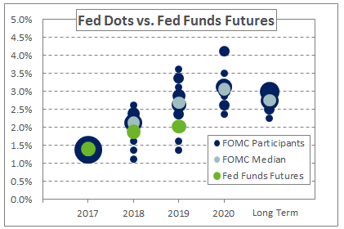
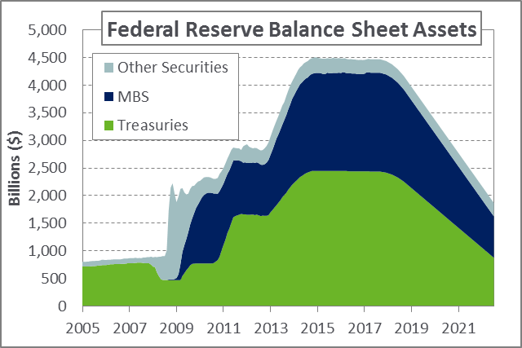
Key Market Themes
Federal Reserve Gradualism
The Federal Reserve is expected to slowly increase interest rates
Expected path of Fed policy through 2020 matters more than timing of the next hike as the disconnect between market expectations and Fed signaling has grown
A relatively accommodative Fed is likely to continue, unless there is a dramatic acceleration in inflation
The Fed’s balance sheet normalization is a low grade tightening of monetary policy but its impact is untested
Fed is expected to be careful and data dependent yet balance sheet disbursement into a strong economy will likely have tightening effects – in the same way balance sheet expansion had easing effects
The balance sheet will gradually shrink over time assuming conditions remain supportive
The gradual progression of balance sheet reduction combined with the accommodative policies of global central banks supports easy global financial conditions
Source: (Top) Bloomberg, NEPC
Source: (Bottom) Bloomberg, NEPC

Slide 35
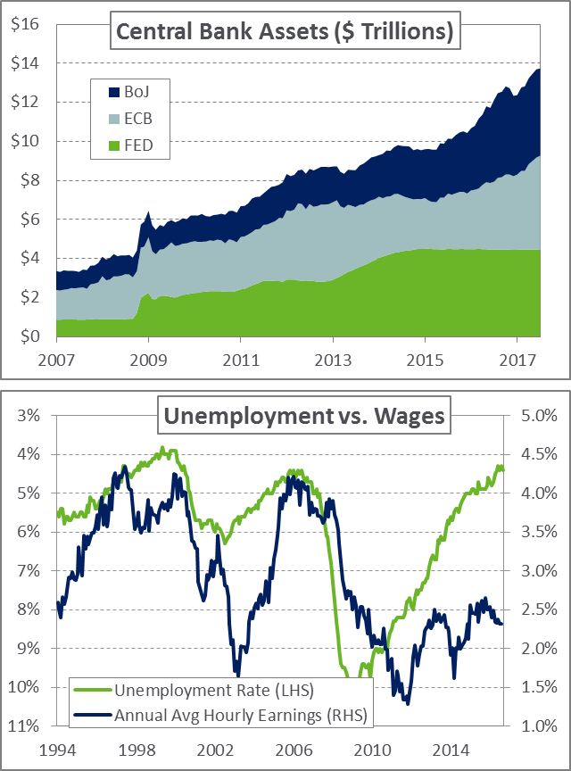
Key Market Themes
Federal Reserve Gradualism
Gradualism is the policy of choice globally as the major central banks manage unprecedented initiatives
ECB’s QE program is expanding but at a slower rate
However, the reinvestment of balance sheet holdings is likely to continue for an extended period of time
Bank of Japan’s QE yield-curve control program has rapidly slowed bond purchases but solidified steepness in the yield curve
Inflation expected to shift marginally higher in the coming years
Improvements in wage growth and aggregate economic activity support modest upticks in inflation but still within the Fed’s tolerance bands to gradually raise rates
Fed has stated a willingness to let the economy “run hot” and accept some inflation to repair the deflationary effects of the past decade
Source: (Top) Bloomberg, NEPC
Source: (Bottom): Bloomberg, FRED

Slide 36
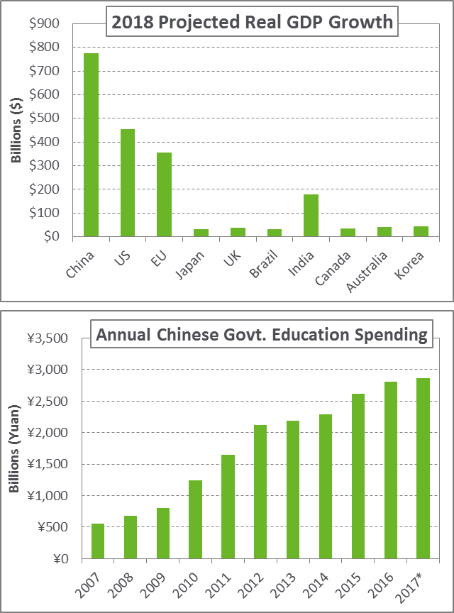
Key Market Themes
China Transitions
China is the global growth engine but faces fundamental transitions
China’s economic transition is pivoting from production and investment focused to a service and consumption based economy
Fixed investment is required to sustain the production based economy and support employment as the rural population moves to urban centers
Any disruption to these transitions will have global repercussions due to China’s role in the global economy
China must manage competing social goals in attempting to sustain growth
Engineering an orderly transition to a consumer-led economy requires supporting employment outside the major cities and improving quality of life metrics such as air quality in the urban centers
Future growth in a services based economy requires advancement in productivity, technology, and a more skilled labor force
Source: (Top) Bloomberg
Source: (Bottom) Bloomberg, *Includes estimate for Nov/Dec 2017

Slide 37
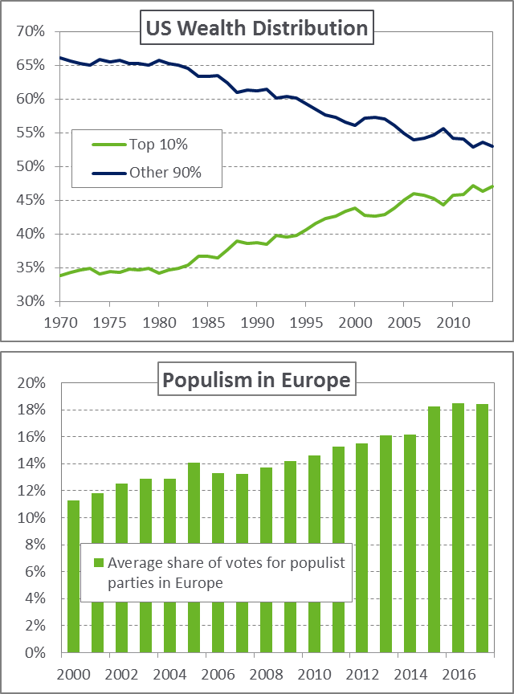
Key Market Themes
Globalization Backlash
Uneven economic growth and wage gains have fueled political discontent in the developed world
Election results in France have assuaged fears of political gridlock in the EU
Italian election in first half of 2018 is another potential flashpoint on globalization
Anti-establishment political bias is likely a long term trend and potentially leads to higher levels of currency volatility over time
For many nations, a turn inward is associated with globalization fatigue
Often fuels greater expression of nationalism and increased geopolitical risks as multilateral relationships are reassessed
Populist movements destabilize the political order and shifts away from political orthodoxy heighten tail risks
However, equity markets often overreact to geopolitical concerns and sell-offs can be a buying opportunity for investors
Source: (Top) World Wealth & Income Database
Source: (Bottom) World Bank

Slide 38
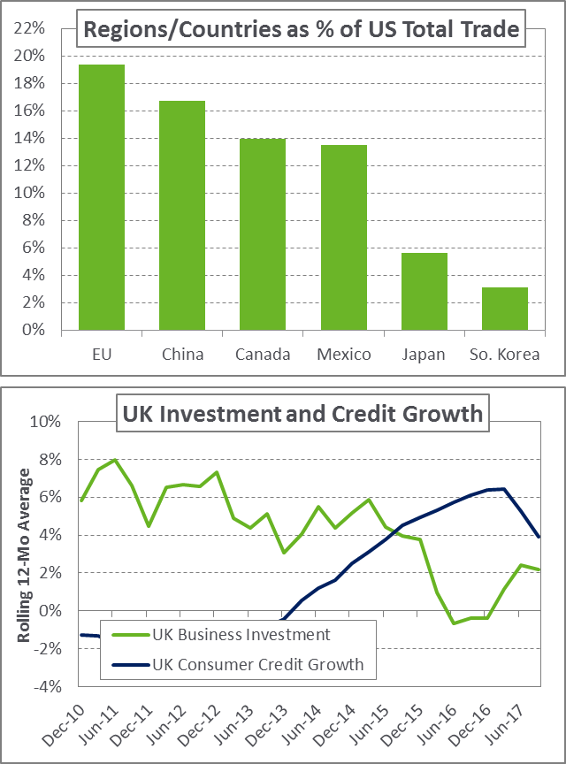
Key Market Themes
Globalization Backlash
Major shifts in US trade policy did not materialize in 2017
However, a more aggressive protectionist policy would represent a material risk to global markets and the world economy
Markets have taken to interpreting the US administration's rhetoric with a grain of salt but ongoing NAFTA negotiations are a concern
The UK serves as a live case study for the effects of globalization backlash
While it is early in the process, economic metrics across the country have turned lower in the 18 months since UK voted to leave the European Union
Expected disruption to financial regulations, customs controls, and business confidence in the UK are proving to be a cautionary tale for a turn away from globalization
However, the economic unease of voters remain and popularity of anti-establishment political parties poses a risk to the global economic order
BREXIT
Vote
Source: (Top) Federal Reserve Bank of St. Louis
Source: (Bottom) Bloomberg

Slide 39
Introduction Asset Class Assumptions

Slide 40
Inflation Overview
Inflation is an integral component of our asset allocation assumptions
Represents an essential building block for developing asset class returns
Inflation building blocks are model driven and informed by multiple sources for both the US and global asset classes
Includes forecasts from international organizations (e.g. IMF), local consumer and producer price indices, break-even inflation expectations, and global interest rate curves
US inflation is based upon the TIPS breakeven inflation curve adjusted for expectations of economic activity, employment, and capacity levels
Global inflation expectations are informed by consensus forecasts across countries along with implied inputs from global bond curves
The 30 year global inflation forecast assumes purchase power parity holds across the globe and country specific inflation levels converge to a terminal value
Region | 5-7 Year Inflation Assumption | 30-Year Inflation Assumption
United States | 2.50% | 2.75%
Global | 3.00% | 3.25%

Slide 41
2018 5-7 year return forecasts
Geometric Expected Return
Asset Class | 2018 | 2017 | 2018-2017
Cash | 2.00% | 1.75% | +0.25%
Treasuries | 2.25% | 2.00% | +0.25%
IG Corp Credit | 3.50% | 3.75% | -0.25%
MBS | 2.50% | 2.25% | +0.25%
Core Bonds* | 2.75% | 2.65% | +0.10%
Non-US Bonds (Unhedged) | 0.50% | 1.00% | -0.50%
EMD Local Currency | 6.00% | 6.75% | -0.75%
Large Cap Equities | 5.25% | 5.75% | -0.50%
Small/Mid Cap Equities | 5.75% | 6.00% | -0.25%
Int'l Equities (Unhedged) | 7.50% | 7.25% | +0.25%
Int'l Equities (Hedged) | 7.82% | 7.57% | +0.25%
Emerging Int'l Equities | 9.00% | 9.50% | -0.50%
Private Equity | 8.00% | 8.25% | -0.25%
Private Debt | 6.50% | 7.25% | -0.75%
ASRS Real Estate | 7.60% | - | -
* Core Bonds assumption based on market weighted blend of components of Aggregate Index (Treasuries, IG Corp Credit, and MBS).
** Hedge Funds is a calculated blend of 40% Equity, 40% Credit, 20% Macro-related strategies.

Slide 42
2018 30 year return forecasts
Geometric Expected Return
Asset Class | 2018 | 2017 | 2018-2017
Cash | 2.75% | 3.00% | -0.25%
Treasuries | 3.25% | 3.50% | -0.25%
IG Corp Credit | 4.75% | 5.00% | -0.25%
MBS | 3.25% | 3.50% | -0.25%
Core Bonds* | 3.75% | 4.00% | -0.25%
Non-US Bonds (Unhedged) | 2.50% | 2.75% | -0.25%
EMD Local Currency | 6.50% | 6.50% | -
Large Cap Equities | 7.50% | 7.50% | -
Small/Mid Cap Equities | 7.75% | 7.75% | -
Int'l Equities (Unhedged) | 7.75% | 7.75% | -
Int'l Equities (Hedged) | 8.14% | 8.14% | -
Emerging Int'l Equities | 9.25% | 9.50% | -0.25%
Private Equity | 9.50% | 9.50% | -
Private Debt | 7.50% | 8.00% | -0.50%
ASRS Real Estate | 8.60% | - | -
* Core Bonds assumption based on market weighted blend of components of Aggregate Index (Treasuries, IG Corp Credit, and MBS).
** Hedge Funds is a calculated blend of 40% Equity, 40% Credit, 20% Macro-related strategies.

Slide 43
2018 Volatility Forecasts
Volatility
Asset Class | Capital Market Volatility | Accounting Volatility
Cash | 1.00% | 1.00%
Treasuries | 5.50% | 5.50%
IG Corp Credit | 7.50% | 7.50%
MBS | 7.00% | 6.50%
Core Bonds* | 5.99% | 5.85%
Non-US Bonds (Hedged) | 4.50% | 3.50%
EMD Local Currency | 13.00% | 13.00%
Large Cap Equities | 17.50% | 16.00%
Small/Mid Cap Equities | 21.00% | 20.50%
Int'l Equities (Unhedged) | 21.00% | 18.50%
Int'l Equities (Hedged) | 18.00% | 15.50%
Emerging Int'l Equities | 28.00% | 25.00%
Private Equity | 23.00% | 12.50%
Private Debt | 13.00% | 8.50%
ASRS Real Estate | 12.50%
* Core Bonds assumption based on market weighted blend of components of Aggregate Index (Treasuries, IG Corp Credit, and MBS).
** Hedge Funds is a calculated blend of 40% Equity, 40% Credit, 20% Macro-related strategies.

Slide 44
Appendix

Slide 45
Assumption Development
Capital market assumptions are published for over 40 asset classes
Assumptions include 5-7 year and 30 year return forecasts, average annual volatility expectations, and correlations
The 5-7 year forecast is designed to capture the return outlook for the current investment cycle
30 year return assumptions reflect a long-term outlook and are informed by the historical relationships among asset classes
Assumptions are published annually on December 15th and use market data as of November 30th
Assumptions are developed by the Asset Allocation Committee and approved by the Partners Research Committee (PRC)
Return assumptions are developed with proprietary valuation models and rely on a core building block methodology
Asset Allocation Committee
September | Asset Allocation Committee Assumptions Kickoff Finalize List of New Asset Class Assumptions
October | Review Draft of Asset Class Return Assumptions Discuss Outlook with NEPC Research Beta Groups
November | Finalize Volatility and Correlation Assumptions Final Update of Asset Class Models (As of 11/30)
December | Review Model Output and Create Return Assumptions Present Draft to the PRC Publish Assumptions on December 15th

Slide 46
Building Blocks Methodology
Forward-looking asset class models incorporate current and forecasted market and economic data to inform expected returns
Quantitative inputs combined with qualitative factors and investor sentiment (capital flows, etc.) drive the 5 to 7 year return outlook
Components are combined to capture core drivers of return across asset classes – forming the foundation of our building blocks framework
Building blocks will vary across equity, credit, and real assets
Illiquidity Premium
Valuation
Inflation
Real Growth
Yield

Slide 47
5-7 Year Return Assumptions
 | Asset Class | 5-7 Year Return | Change 2018-2017 | Volatility
 | Cash | 2.00% | +.25% | 1.00%
 | US Inflation | 2.50% | - | -
Equity | Large Cap Equities | 5.25% | -.50% | 17.50%
 | International Equities (Unhedged) | 7.50% | +.25% | 21.00%
 | Emerging International Equities | 9.00% | -.50% | 28.00%
 | Private Equity | 8.00% | -.25% | 23.00%
Rates/Credit | Treasuries | 2.25% | +.25% | 5.50%
 | Core Bonds | 2.75% | +.10% | 5.99%
 | Municipal Bonds 1-10 Year | 2.50% | - | 5.50%
 | High Yield Bonds | 3.75% | -1.00% | 13.00%
 | Private Debt | 6.50% | -.75% | 13.00%
Real Assets | Commodities | 4.75% | - | 19.00%
 | REITs | 6.50% | - | 21.00%
 | Core Real Estate | 5.75% | -.25% | 13.00%
Multi-Asset | US 60/40* | 4.54% | -.24% | 10.99%
 | Global 60/40* | 4.91% | -.13% | 11.78%
 | Global Trading Strategies* | 5.83% | -.10% | 9.07%
*Each calculated as a blend of other asset classes

Slide 48
2018 correlations
Asset Class | Cash | US Lev | Tsy | IG | MBS | TIPS | HY | Non-US Bonds (U) | Non-US Bonds (H) | EMD (Ext) | EMD (Loc) | Large Cap | SMID | Int'l (U) | Int’l (H) | EME | PE | PD | PRA - Egy/Met | PRA: Infra/ Land | Core RE | Commodities
Cash | 1.00 | 0.90 | 0.20 | 0.10 | 0.25 | 0.35 | -0.05 | 0.10 | 0.15 | 0.05 | 0.05 | -0.10 | -0.15 | -0.10 | -0.10 | -0.10 | -0.20 | 0.00 | -0.05 | 0.15 | 0.10 | 0.10
US Lev | 0.90 | 1.00 | 0.20 | 0.10 | 0.25 | 0.35 | -0.05 | 0.10 | 0.15 | 0.05 | 0.05 | -0.10 | -0.15 | -0.10 | -0.10 | -0.10 | -0.25 | 0.00 | -0.05 | 0.15 | 0.10 | 0.10
Treasuries | 0.20 | 0.20 | 1.00 | 0.65 | 0.85 | 0.65 | 0.10 | 0.45 | 0.70 | 0.20 | 0.10 | -0.10 | -0.15 | -0.10 | -0.10 | -0.20 | -0.15 | -0.35 | -0.20 | -0.05 | 0.10 | -0.10
IG | 0.10 | 0.10 | 0.65 | 1.00 | 0.75 | 0.65 | 0.55 | 0.45 | 0.60 | 0.60 | 0.50 | 0.25 | 0.25 | 0.30 | 0.30 | 0.35 | 0.30 | 0.15 | 0.20 | 0.10 | 0.15 | 0.15
MBS | 0.25 | 0.25 | 0.85 | 0.75 | 1.00 | 0.65 | 0.30 | 0.45 | 0.60 | 0.35 | 0.25 | 0.10 | 0.10 | 0.05 | 0.05 | -0.10 | 0.10 | -0.15 | -0.05 | -0.05 | 0.05 | 0.00
TIPS | 0.35 | 0.35 | 0.65 | 0.65 | 0.65 | 1.00 | 0.20 | 0.40 | 0.65 | 0.30 | 0.25 | -0.10 | -0.10 | -0.05 | -0.05 | -0.10 | -0.10 | -0.10 | -0.05 | 0.05 | 0.10 | 0.30
HY | -0.05 | -0.05 | 0.10 | 0.55 | 0.30 | 0.20 | 1.00 | 0.10 | 0.20 | 0.70 | 0.55 | 0.65 | 0.70 | 0.65 | 0.65 | 0.70 | 0.60 | 0.65 | 0.50 | 0.40 | 0.35 | 0.20
Non-US Bonds (U) | 0.10 | 0.10 | 0.45 | 0.45 | 0.45 | 0.40 | 0.10 | 1.00 | 0.40 | 0.30 | 0.35 | 0.00 | -0.05 | 0.35 | 0.05 | 0.25 | -0.15 | -0.10 | -0.10 | 0.05 | 0.15 | 0.10
Non-US Bonds (H) | 0.15 | 0.15 | 0.70 | 0.60 | 0.60 | 0.65 | 0.20 | 0.40 | 1.00 | 0.30 | 0.20 | -0.10 | -0.15 | -0.10 | -0.10 | -0.20 | -0.20 | -0.10 | -0.15 | 0.00 | 0.05 | -0.10
EMD (Ext) | 0.05 | 0.05 | 0.20 | 0.60 | 0.35 | 0.30 | 0.70 | 0.30 | 0.30 | 1.00 | 0.75 | 0.55 | 0.55 | 0.60 | 0.60 | 0.70 | 0.35 | 0.50 | 0.40 | 0.35 | 0.25 | 0.35
EMD (Local) | 0.05 | 0.05 | 0.10 | 0.50 | 0.25 | 0.25 | 0.55 | 0.35 | 0.20 | 0.75 | 1.00 | 0.60 | 0.50 | 0.70 | 0.65 | 0.80 | 0.40 | 0.60 | 0.40 | 0.40 | 0.40 | 0.50
Large Cap | -0.10 | -0.10 | -0.10 | 0.25 | 0.10 | -0.10 | 0.65 | 0.00 | -0.10 | 0.55 | 0.60 | 1.00 | 0.90 | 0.70 | 0.75 | 0.65 | 0.70 | 0.60 | 0.65 | 0.50 | 0.40 | 0.30
SMID Cap | -0.15 | -0.15 | -0.15 | 0.25 | 0.10 | -0.10 | 0.70 | -0.05 | -0.15 | 0.55 | 0.50 | 0.90 | 1.00 | 0.65 | 0.70 | 0.65 | 0.75 | 0.65 | 0.70 | 0.50 | 0.40 | 0.30
Int'l Eqty (U) | -0.10 | -0.10 | -0.10 | 0.30 | 0.05 | -0.05 | 0.65 | 0.35 | -0.10 | 0.60 | 0.70 | 0.70 | 0.65 | 1.00 | 0.85 | 0.70 | 0.60 | 0.75 | 0.55 | 0.45 | 0.35 | 0.40
Int'l Eqty (H) | -0.10 | -0.10 | -0.10 | 0.30 | 0.05 | -0.05 | 0.65 | 0.05 | -0.10 | 0.60 | 0.65 | 0.75 | 0.70 | 0.85 | 1.00 | 0.70 | 0.65 | 0.75 | 0.60 | 0.45 | 0.40 | 0.30
EM | -0.10 | -0.10 | -0.20 | 0.35 | -0.10 | -0.10 | 0.70 | 0.25 | -0.20 | 0.70 | 0.80 | 0.65 | 0.65 | 0.70 | 0.70 | 1.00 | 0.45 | 0.80 | 0.50 | 0.40 | 0.30 | 0.55
PE | -0.20 | -0.25 | -0.15 | 0.30 | 0.10 | -0.10 | 0.60 | -0.15 | -0.20 | 0.35 | 0.40 | 0.70 | 0.75 | 0.60 | 0.65 | 0.45 | 1.00 | 0.65 | 0.85 | 0.60 | 0.50 | 0.25
PD | 0.00 | 0.00 | -0.35 | 0.15 | -0.15 | -0.10 | 0.65 | -0.10 | -0.10 | 0.50 | 0.60 | 0.60 | 0.65 | 0.75 | 0.75 | 0.80 | 0.65 | 1.00 | 0.65 | 0.50 | 0.40 | 0.30
PRA - Egy/Met | -0.05 | -0.05 | -0.20 | 0.20 | -0.05 | -0.05 | 0.50 | -0.10 | -0.15 | 0.40 | 0.40 | 0.65 | 0.70 | 0.55 | 0.60 | 0.50 | 0.85 | 0.65 | 1.00 | 0.75 | 0.45 | 0.35
PRA – Infra/Land | 0.15 | 0.15 | -0.05 | 0.10 | -0.05 | 0.05 | 0.40 | 0.05 | 0.00 | 0.35 | 0.40 | 0.50 | 0.50 | 0.45 | 0.45 | 0.40 | 0.60 | 0.50 | 0.75 | 1.00 | 0.70 | 0.40
Core RE | 0.10 | 0.10 | 0.10 | 0.15 | 0.05 | 0.10 | 0.35 | 0.15 | 0.05 | 0.25 | 0.40 | 0.40 | 0.40 | 0.35 | 0.40 | 0.30 | 0.50 | 0.40 | 0.45 | 0.70 | 1.00 | 0.30
Commodities | 0.10 | 0.10 | -0.10 | 0.15 | 0.00 | 0.30 | 0.20 | 0.10 | -0.10 | 0.35 | 0.50 | 0.30 | 0.30 | 0.40 | 0.30 | 0.55 | 0.25 | 0.30 | 0.35 | 0.40 | 0.30 | 1.00

Slide 49
Macro Assumptions

Slide 50
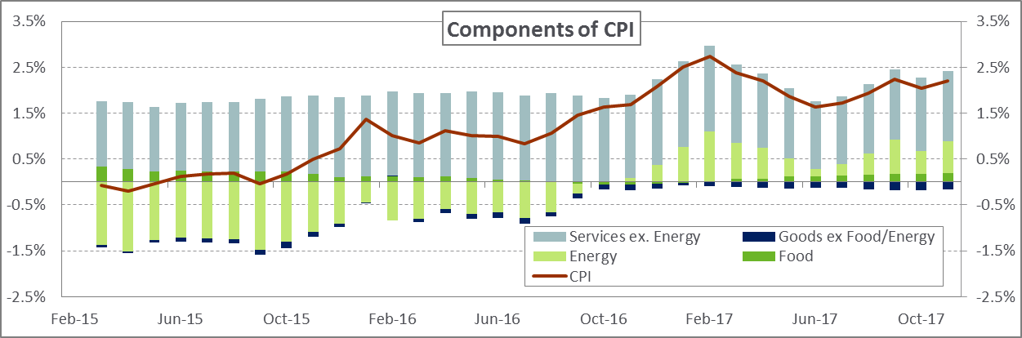
US Inflation
Source: Bloomberg, NEPC
Low inflation continued throughout 2017 despite strong economic growth, tightening labor market, and early signs of wage gains
These metrics were thought to help inflation accelerate, yet the Fed’s 2% inflation target has been a difficult target for the US economy to maintain
A seemingly transitory drop in certain CPI elements, such as healthcare costs and vehicles, have minimized price pressures in 2017 even as the impact from energy prices has turned positive
The Fed’s preferred inflation measure, the personal consumption expenditures (PCE), remains below their 2% target
However, other more inclusive indicators such as the NY Fed Underlying Inflation Gauge, point to an increase in inflation in the coming years, but still below the long-term average

Slide 51
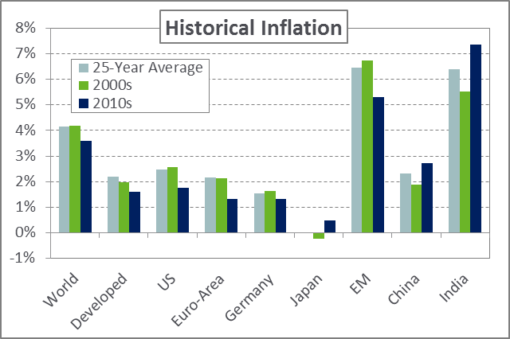
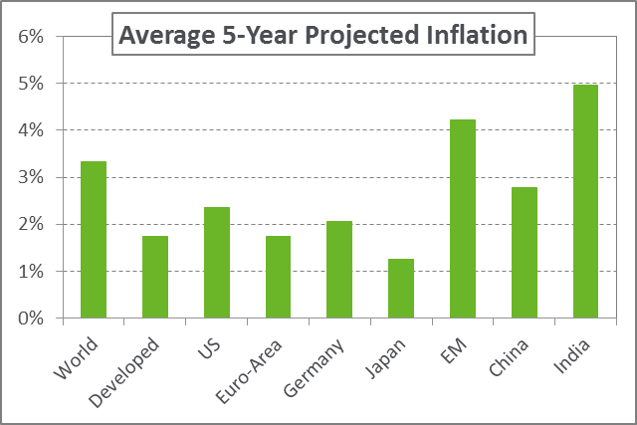
Global Inflation
In most developed economies, core inflation has failed to reach or exceed central bank targets despite improved domestic demand and labor markets
Ultra accommodative monetary policy remains in place for Europe and Japan to fuel higher levels of inflation
The UK is an exception to this trend as significant depreciation of the pound has led to higher consumer prices
Emerging market inflation has broadly declined over the last 24 months
This is in part due to the large fiscal correction and prudent monetary policy actions that followed the currency declines of prior years
Core inflation particularly in Russia and Brazil have declined significantly as the effect of high real interest rates weakens inflationary trends
Source: (Top) IMF, NEPC
Source: (Bottom) IMF, NEPC

Slide 52
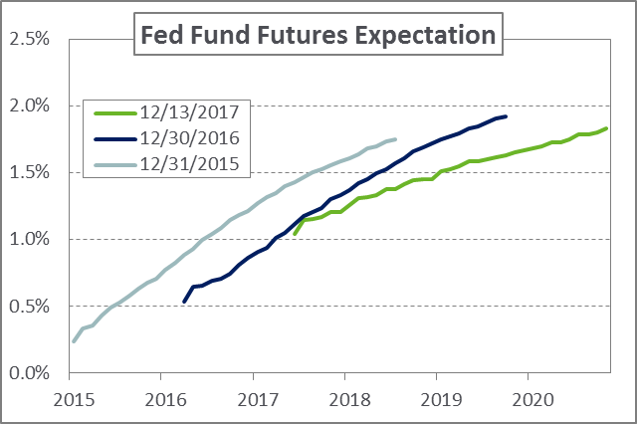
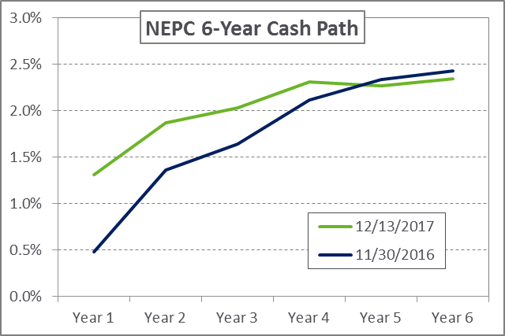
US Cash Expectations
Cash is the basic cornerstone of all asset class forecasts
The assumption flows through as a direct building block component or as a relative value adjustment (cash + risk premia)
The longer-term cash assumption is a result of the inflation assumption in conjunction with our forecasted real interest rate path
After three Fed rate hikes in 2017, expectations for increased short term interest rates project higher still
A progressively flatter yield curve has formed as longer-term rate expectations remain muted
Market prices reflect only two rate hikes in 2018, despite FOMC expectations of three
A key risk to our overall investment outlook is the ending of Fed gradualism and rate increases beyond market expectations
Source: (Top) Bloomberg
Source: (Bottom) Bloomberg, NEPC
Charts as of 12/13/2017
Notes:
1.31, 2.08, 2.01, 2.2, 2.15, 1.74 OR 1.31 1.87 2.03 2.31 2.27 2.35
0.48, 1.36, 1.64, 2.12, 2.34, 2.43

Slide 53
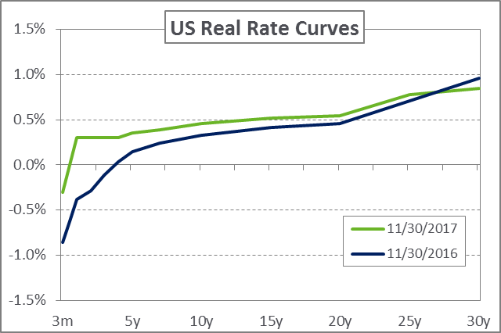
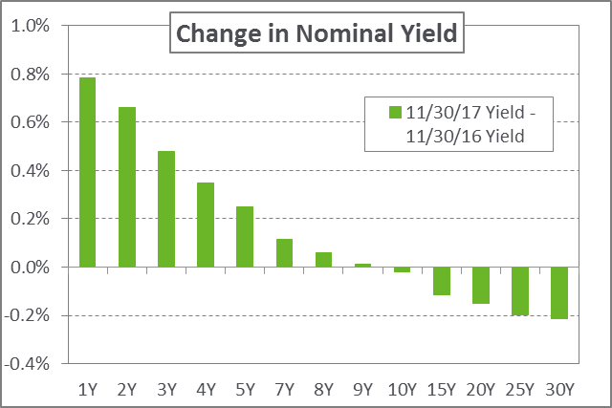
US Interest Rate Expectations
Real yields are marginally higher relative to last year
Continued strength in economic data and expectation of future Fed rate hikes have improved the outlook for real yields
While higher, real rates remain below long-term averages, reinforcing the subdued outlook for fixed income
Long-term expectations for real yields remain positive but low in the US
Low real rates depress the return outlook for risk assets over the long-term
Interest rate increases have been slower than what the market has discounted
Additional uncertainty surrounding the path of rates is possible in 2018
Potential disruption with the confirmation of new Fed Chairman Jerome Powell
Tax cuts could push interest rates higher due to the larger federal deficits and debt issuance needs
Source: (Top) Bloomberg, NEPC
Source: (Bottom) Bloomberg

Slide 54
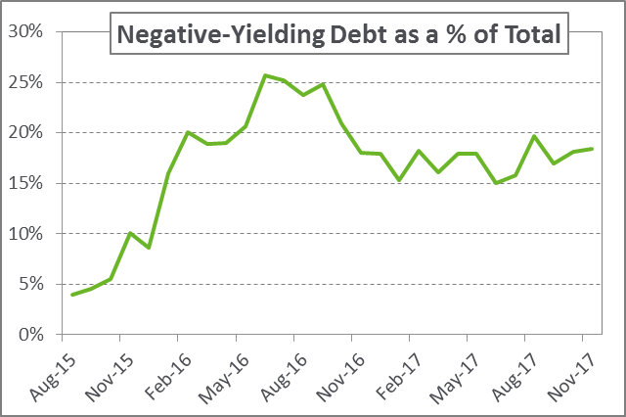
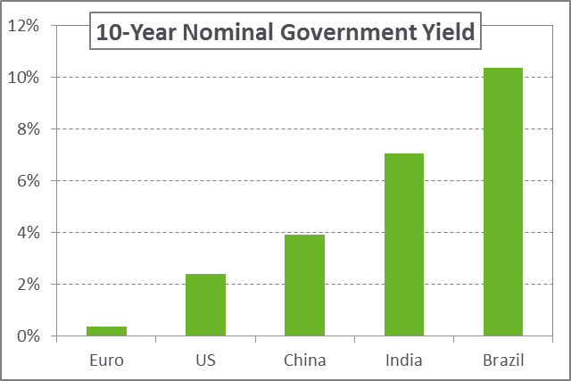
Global Interest Rate Expectations
Government bond yields remain low and negative in much of the developed world
European sovereign yields have declined relative to Germany as political and economic risk declines
Spain and other periphery nations have showed positive economic momentum
France’s election of Emmanuel Macron was seen as a stabilizing event for the country and the EU as a whole
Emerging market local interest rates are attractively priced as real yields remain elevated
Emerging market yields continue to retain a healthy premia over developed world rates
Additionally, positive real rates provide a larger cushion for EM central banks to cut interest rates and ease monetary conditions
Source: (Top) Bloomberg
Source: (Bottom) Bloomberg

Slide 55
Equity: Assumptions
Equity Building Blocks
Illiquidity Premium | The additional return expected for investments carrying liquidity risk
Valuation | An input representing P/E multiple contraction or expansion relative to long-term trend
Inflation | Represents market-specific inflation derived from index country revenue contribution and region-specific forecasted inflation
Real Earnings Growth | Reflects market-specific real growth for each equity asset class as a weighted-average derived from index country revenue contribution and forecasted GDP growth
Dividend Yield | Informed by current income distributed to shareholders with adjustments made to reflect market conditions and trends
Asset Class | 5-7 Year Return | Change 2018-2017
US Large Cap | 5.25% | -.50%
US Small/Mid-Cap | 5.75% | -.25%
International (Unhedged) | 7.50% | +.25%
International (Hedged) | 7.82% | +.25%
International Small Cap | 7.75% | +.25%
Emerging International | 9.00% | -.50%
Emerging Intl. Small Cap | 9.25% | -.75%
Private Equity | 8.00% | -.25%
Hedge Funds – Long/Short | 6.25% | -
Global Equity | 6.88% | -.33%

Slide 56
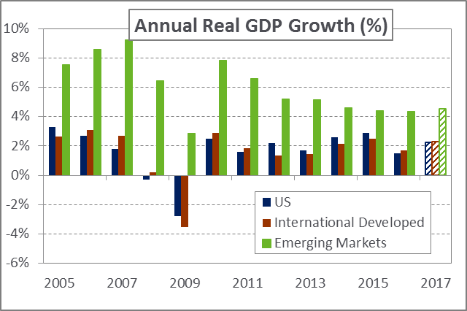
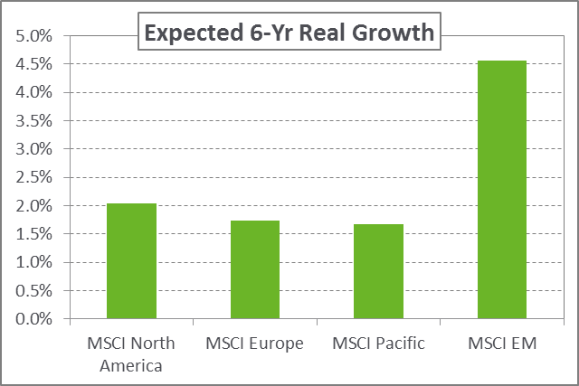
Equity: Real Earnings Growth
Global growth was stronger than expected during 2017
Synchronized global growth is likely to persist with continued favorable market growth conditions
The broad outlook for developed economies has improved as a real earnings recovery has begun
The UK remains a notable outlier as the country continues sorting through Brexit
Emerging economies are broadly expected to continue strong growth
Chinese real growth is expected to slow in future years as the country transitions to a more consumer based economy
Reforms in India and southeast Asia are expected to boost investment, productivity, and per-capita growth
Source: (Top) Bloomberg, NEPC
Source: (Bottom) IMF, MSCI, Bloomberg

Slide 57
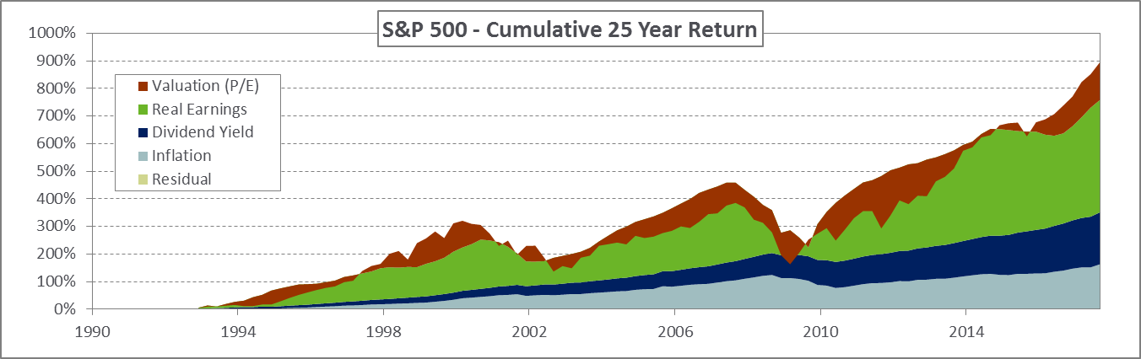
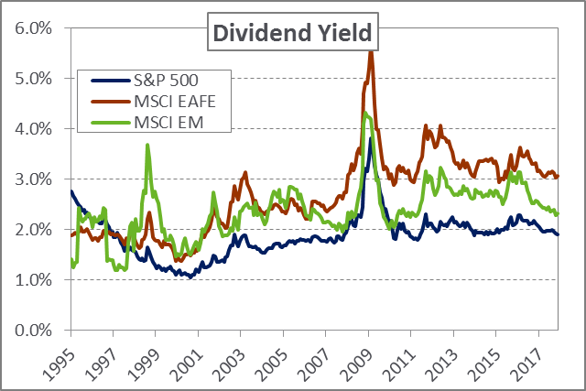
Equity: Dividend Yield
Real dividends per share have increased over time, but prices have increased at a faster rate, leading to falling yields
International and Emerging Markets continue to offer a more attractive dividend yield relative to the US
Source: (Top) S&P, NEPC, Bloomberg
Source: (Bottom) S&P, MSCI, Bloomberg

Slide 58
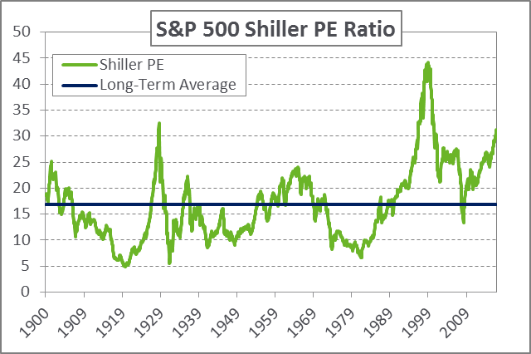
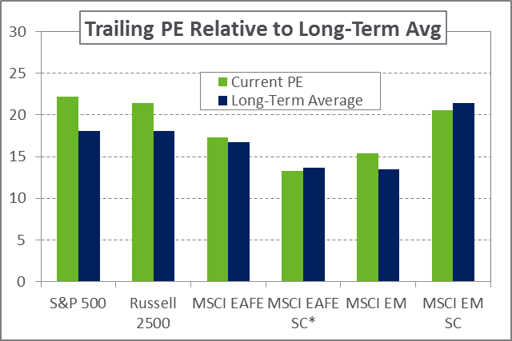
Equity: Valuation
Global equities broadly pushed higher in 2017 supported by macroeconomic data, robust earnings, and easy financial conditions
While earnings growth in the US came in stronger than expected, price gains continued to outpace – leading to further P/E multiple expansion
Recovering corporate earnings for international developed markets have allowed valuations to remain relatively attractive
A multi-year earnings recovery in Europe and Japan offers the potential for an elevated return in these markets
While emerging market equities posted the strongest gains for 2017, valuations remain close to long-term averages relative to domestic markets
Source: (Top) S&P, Shiller
Source: (Bottom) S&P, Russell, MSCI, Bloomberg
*Reflects index-adjusted positive P/E values

Slide 59
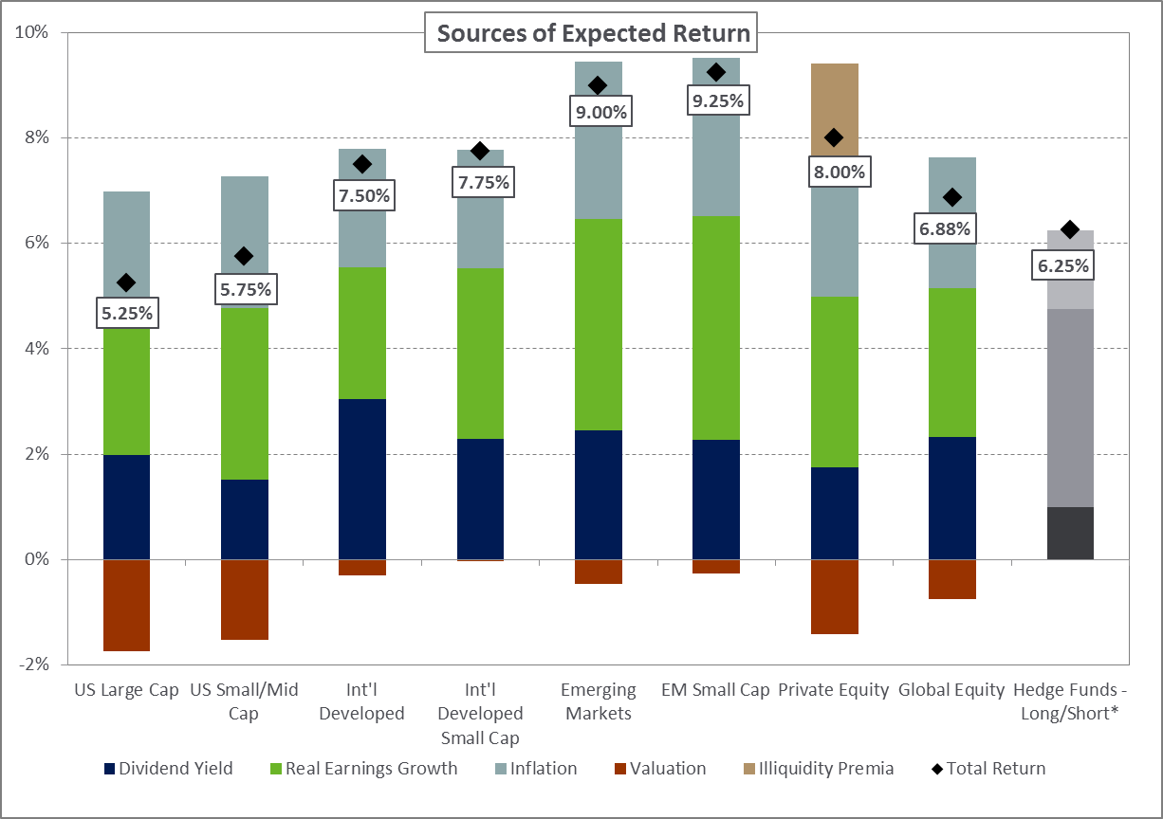
Equity: Building Blocks
Source: NEPC
*Hedge Funds are discussed in detail in the Multi-Asset section

Slide 60
Rates & Credit: Assumptions
Rate & Credit Building Blocks
Illiquidity Premium | The additional return expected for investments carrying liquidity risk
Government Rates Price Change | The valuation change resulting from a change in the current yield curve to forecasted rates
Spread Price Change | The valuation change resulting from a change in credit spreads over the duration of the investment and highly sensitive to economic cycles
Credit Deterioration | The average loss for credit securities associated with an expected default cycle and recovery rates
Credit Spread | Additional yield premium provided by securities with credit risk
Government Rates | The yield attributed to sovereign bonds that do not have credit risk associated with their valuation
Asset Class | 5-7 Year Return | Change 2018-2017
Treasuries | 2.25% | +.25%
Investment-Grade Corporate Credit | 3.50% | -.25%
Municipal Bonds | 2.50% | +.25%
TIPS | 3.25% | +.25%
High-Yield Bonds | 3.75% | -1.00%
High-Yield Municipal Bonds | 3.75% | -.50%
Bank Loans | 4.50% | -.75%
Non-US Bonds (Unhedged) | 0.50% | -.50%
EMD (External) | 4.25% | -.50%
EMD (Local Currency) | 6.00% | -.75%
Private Debt | 6.50% | -.75%
Core Bonds | 2.75% | +.10%

Slide 61
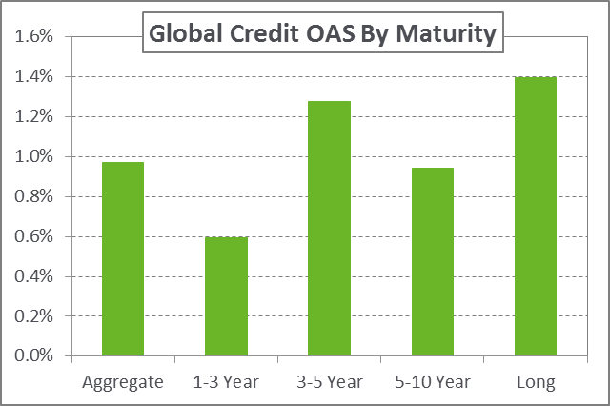
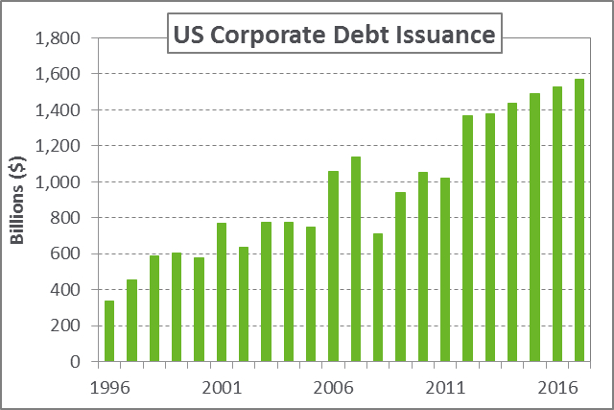
Rates & Credit: Credit Spread
Strong global growth and yield- seeking investor behavior has compressed credit spreads
Economic growth usually translates to tighter credit spreads due to a lower probability of defaults
In Europe, the ECB’s decision to include corporate bonds in its quantitative easing program has also contributed to smaller credit risk premiums globally
Low borrowing costs have encouraged record issuance in both investment grade and high yield bonds
Passive ownership of credit has increased significantly, even with a larger denominator
The outlook for US credit is subdued with limited return opportunities as credit spreads trade below long-term medians
Source: (Top) Barclays, Bloomberg
Source: (Bottom) SIFMA

Slide 62
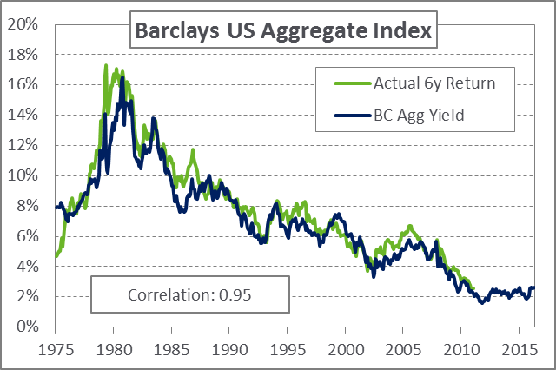
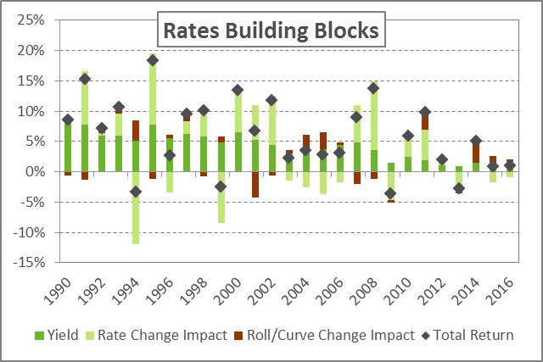
Rates & Credit: rates Price Change
Rates price change include changes in the level of interest rates, changes to the shape of the curve, and roll down
Roll down refers to expected price change due to aging of a bond along the curve
Rate change impact often dominates total return and is a likely detractor in the coming cycle, given expectations of modestly higher rates
Path of interest rates for each market is tied to both central bank actions and inflation expectations
Roll down offers some relief to rising rates when yield curves are steep
As yield curve flattens this can be a drag, pushing investors to shorter duration bonds
Source: (Top) Barclays, Bloomberg, NEPC
Source: (Bottom) Barclays, Bloomberg, NEPC

Slide 63
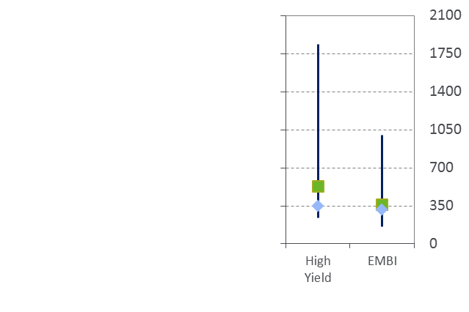
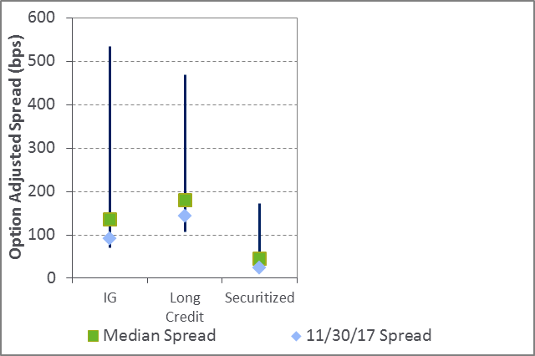
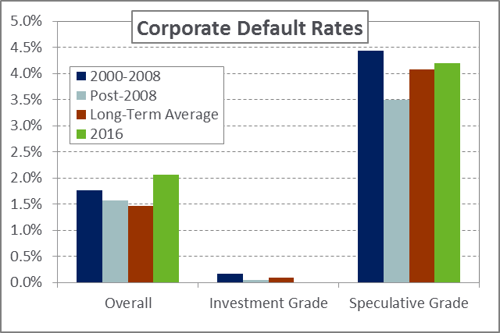
Rates & Credit: Spread Price Change
Credit spreads continued to tighten throughout the year and remain below long-term averages
With positive economic indicators and strong technicals, spreads could grind lower
The number of defaults increased last year as a result of the depressed energy and natural resources sector
Over 50% of credit defaults occurred within the energy sector
Nearly all other sectors experienced default rates well below long-term averages
Credit spreads near historic lows suggest investors are receiving less compensation for taking on risk
Source: (Top) JPM, Bloomberg, NEPC. As of 01/31/2000
Source: (Bottom) S&P, NEPC

Slide 64
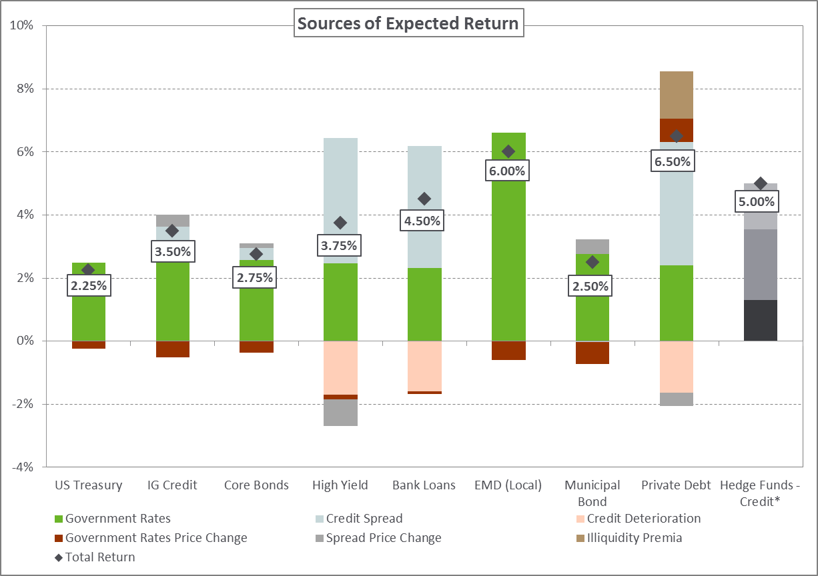
Credit: Building Blocks
Source: NEPC *Hedge Funds are discussed in detail in the Multi-Asset section

Slide 65
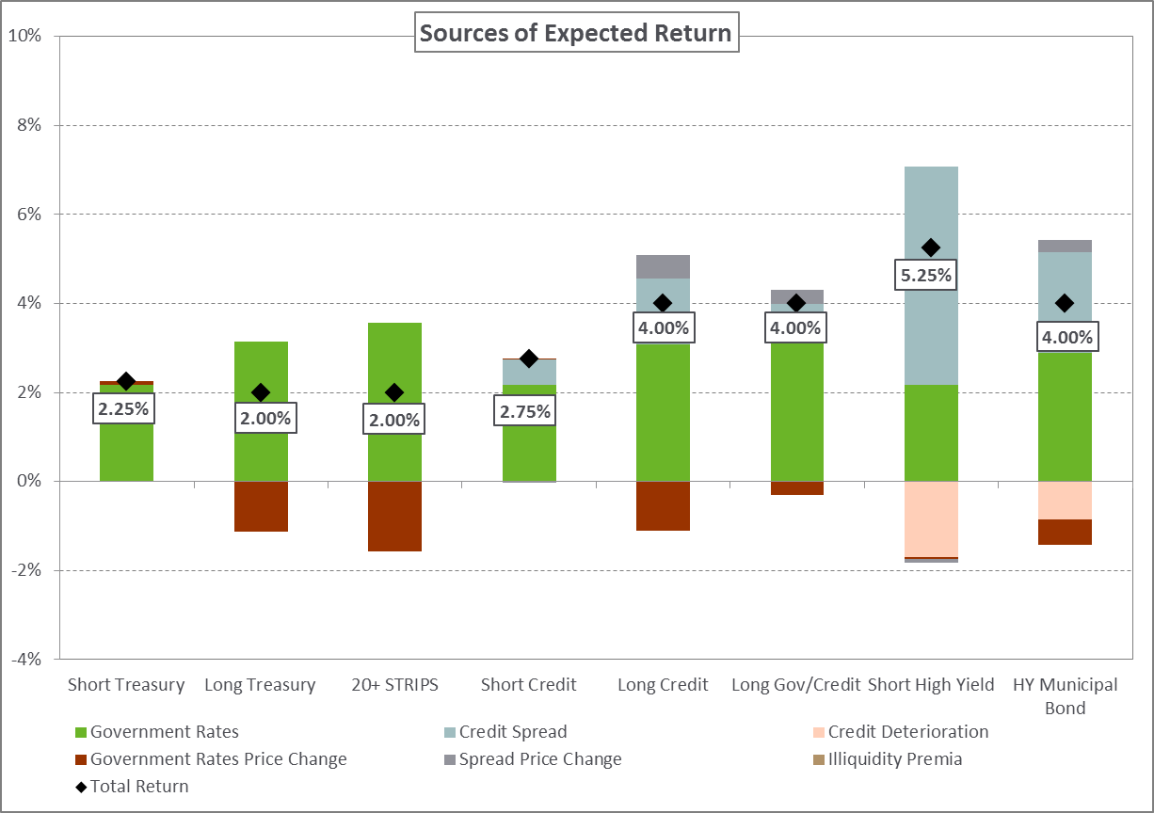
credit: Building Blocks
Source: NEPC

Slide 66
Real Assets: Assumptions
Real Assets Building Blocks
Illiquidity Premium | The additional return expected for investments carrying liquidity risk
Valuation | The expected change in price of the underlying asset reverting to a long-term real average or terminal value assumption
Inflation | Incorporates the inflation paths as defined by TIPS breakeven expectations and NEPC expected inflation assumptions
Real Earnings Growth | Reflects market-specific real growth for each equity asset class as a weighted-average derived from index country revenue contribution and forecasted GDP growth
Real Income | Represents the inflation-adjusted income produced by the underlying tangible or physical asset
Asset Class | 5-7 Year Return | Change 2018-2017
Commodities | 4.75% | -
MLPs | 7.25% | +.25%
REITs | 6.50% | -
Core Real Estate | 5.75% | -.25%
Non-Core Real Estate | 7.00% | N/A
Private Real Assets: Energy/Metals | 8.00% | -.25%
Private Real Assets: Infrastructure/Land | 6.00% | -
Real Assets (Liquid) | 5.87% | -.05%

Slide 67
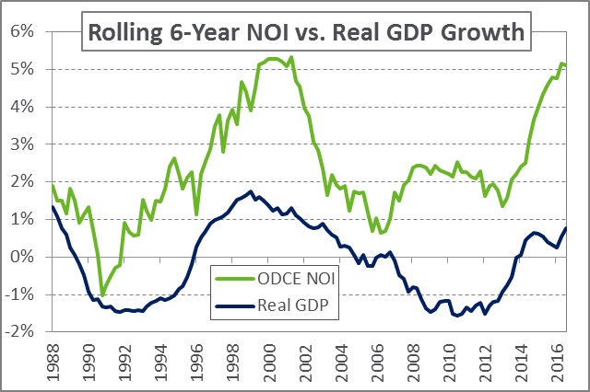
Real Assets: Real Income
Equity-like investments: Real income represents the inflation-adjusted dividend yield
Includes MLPs, natural resource equities, global infrastructure equities, and REITs
Notably, MLP yields have increased relative to last year in combination with generally stronger balance sheets and a double-digit price decline
Real Estate: Real income growth is a function of Net Operating Income (NOI) growth
Rolling 6-year NOI growth exhibits cyclically economic pattern and appears to be at or near its peak
Commodities: Real income is represented by collateral return
A cash proxy is used to represent the collateral and as such, it represents the return on cash over the investment horizon
Real Asset Yields | 11/30/16 | 11/30/17
MLPs | 7.4% | 8.1%
Core Real Estate | 4.7% | 4.6%
US REITs | 4.6% | 4.0%
Global REITs | 4.2% | 3.6%
Global Infrastructure Equities | 4.1% | 3.9%
Natural Resource Equities | 3.0% | 3.3%
US 10-Yr Breakeven Inflation | 2.0% | 1.9%
Commodity Index Roll Yield | -6.5% | -1.4%
Source: (Top) NCREIF, Bloomberg, NEPC
Source: (Bottom) NCREIF, Alerian, NAREIT, S&P, Bloomberg

Slide 68
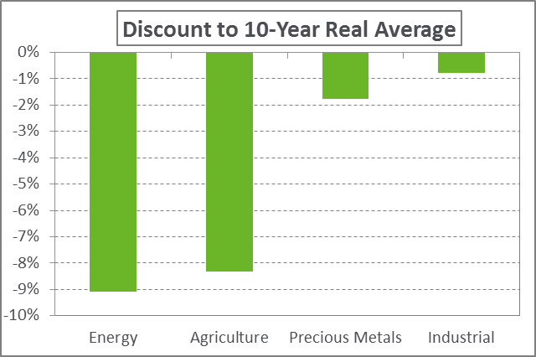
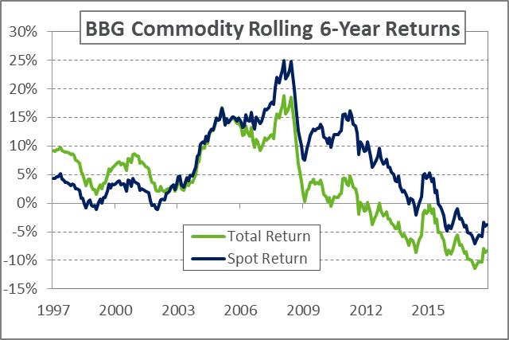
Real Assets: Valuation
Change in commodity valuations can be attributed to both roll yield and change in spot price
Commodity prices continue to trade below their long-term real averages, particularly in the energy and agriculture sectors
Roll yield continues to be a hurdle for investing in commodity futures
Post-2008, spot returns have had consistently higher returns than total return indices – demonstrating the impact of negative roll yield on overall investments
In the latter half of 2017, commodity prices rallied off mid-year lows, causing the negative roll yield to be much smaller relative to last year
Source: (Top) Bloomberg, NEPC
Source: (Bottom) Bloomberg, NEPC

Slide 69
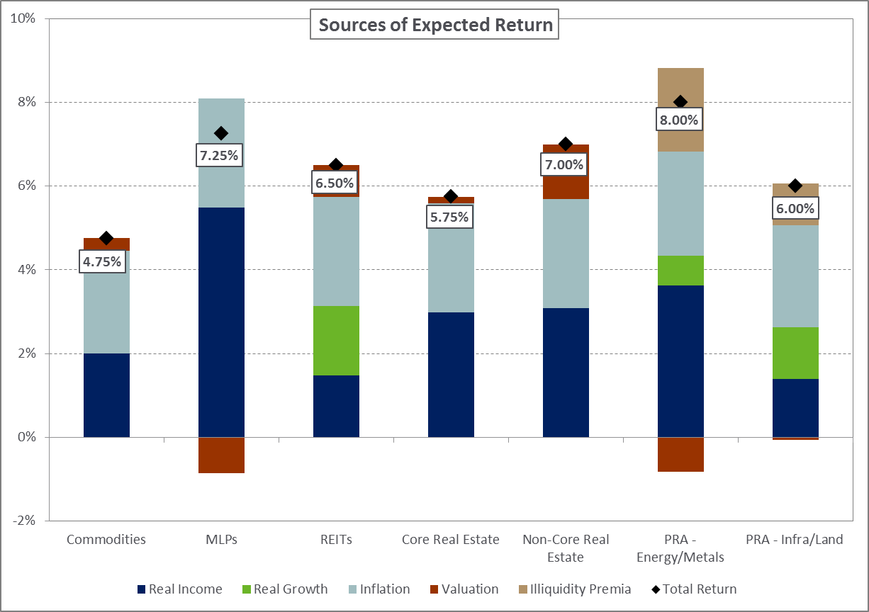
Real Assets: Building Blocks
Source: NEPC
Notes:
Liquid Real Assets: 10% REITs, 40% Commodities, 11.25%LC, 3.75%SMD, Int’l Unhedged 7.5%, 7.5% EME, 20% TIPS

Slide 70
Multi-Asset & Derived Composites
Multi-asset assumptions are the result of the sum of equity, credit, and real asset building blocks
Global 60/40: 60% global equity and 40% global bonds
US 60/40: 60% US equity and 40% core bonds
Risk Parity 10% Vol: Average of 3 common risk parity exposures
GAA Strategies: Average of 3 common GAA exposures
Global Equity: Market weighted blend of MSCI ACWI IMI (US, Non-US Developed, Emerging)
Core Bonds: Market weighted blend of Bloomberg Barclays US Aggregate Bond Index (Treasuries, IG Credit, MBS)
Real Assets (Liquid): Weighted blend of TIPS, global equities, REITs, and commodities
Hedge Funds: Weighted blend of 40% HF equity, 40% HF credit , and 20% HF macro
Asset Class | 5-7 Year Return | Change 2018-2017
Global 60/40 | 4.91% | -.13%
US 60/40 | 4.54% | -.24%
Risk Parity 10% Vol | 5.11% | +.04%
GAA Strategies | 5.44% | -.11%
Hedge Funds – Macro Strategies | 6.25% | -
Global Equity | 6.88% | -.33%
Core Bonds | 2.75% | +.10%
Real Assets (Liquid) | 5.87% | -.05%
Hedge Funds | 5.83% | -.12%

Slide 71
Proprietary Tools

Slide 72
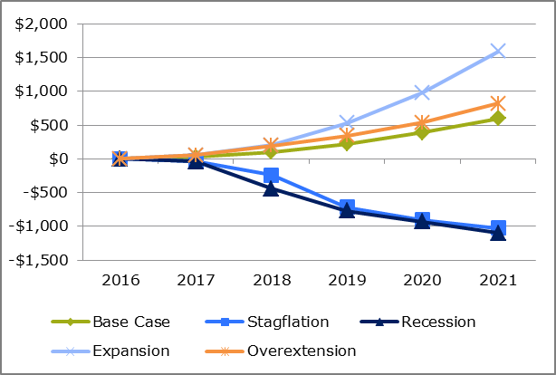
Proprietary Modeling Tools: Scenario Analysis
Scenario analysis tests the viability of asset mixes under multiple economic scenarios
This risk tolerance exercise considers multi-standard deviation events over longer time frames (3-5 years)
Often ignored/underappreciated in traditional mean-variance analysis
Scenario analysis and stress testing focuses investors’ attention on outcomes that depart significantly from “expectations”
Discards baseline return and risk and forces consideration of alternative outcomes
Overextension
Stagflation
Recession
Expansion
High Growth
High Inflation
Base
Case
Low Growth
Low Inflation
Notes:
72

Slide 73
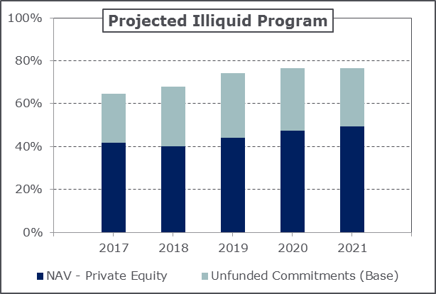
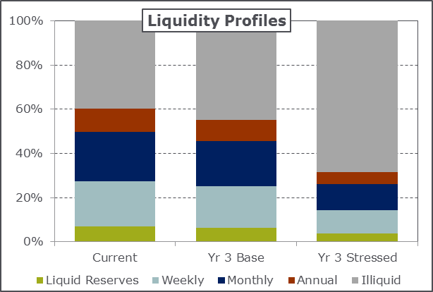
Proprietary Modeling Tools: Liquidity Analysis
Improves perspective on illiquidity, a risk not captured in many traditional portfolio tools
Illiquid exposure can magnify adverse events under stressed market conditions
Liquidity analysis highlights portfolio impact of changing cash flow demands
Must consider the interplay of multiple factors across various market environments
Investment returns
Benefit payments
Contributions
Unfunded capital commitments
Customized stress test can help frame the nature and magnitude of any potential liquidity issues
Provides guidance on the appropriate size of illiquid program
Notes:
73

Slide 74
Information Disclaimer
Past performance is no guarantee of future results.
The goal of this report is to provide a basis for substantiating asset allocation recommendations. The opinions presented herein represent the good faith views of NEPC as of the date of this report and are subject to change at any time.
Information on market indices was provided by sources external to NEPC. While NEPC has exercised reasonable professional care in preparing this report, we cannot guarantee the accuracy of all source information contained within.
All investments carry some level of risk. Diversification and other asset allocation techniques do not ensure profit or protect against losses.
This report is provided as a management aid for the client’s internal use only. This report may contain confidential or proprietary information and may not be copied or redistributed to any party not legally entitled to receive it.

